Slide 1


COMPUTER NETWORKS FINAL PROJECT
TABLE OF CONTENT
1.Hardware configuration
2.ACTIVE DIRECTORY SETUP
3.LINUX SERVER SETUP(REDHAT)
4.EXCHANGE SERVER SETUP
5.WEB SERVER SETUP IIS
6. PFSENSE FIREWALL CONFIGURATION

Slide 2
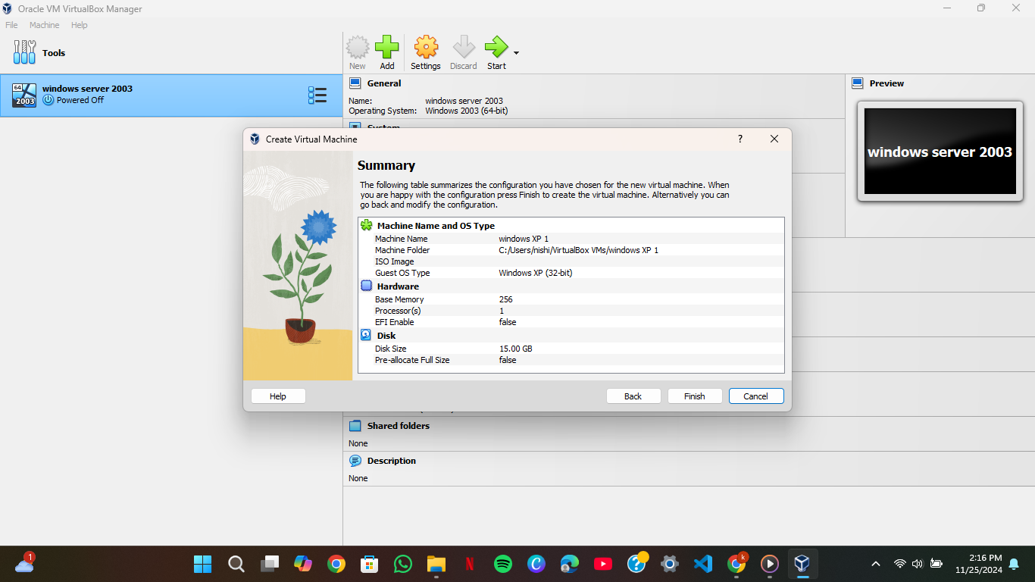
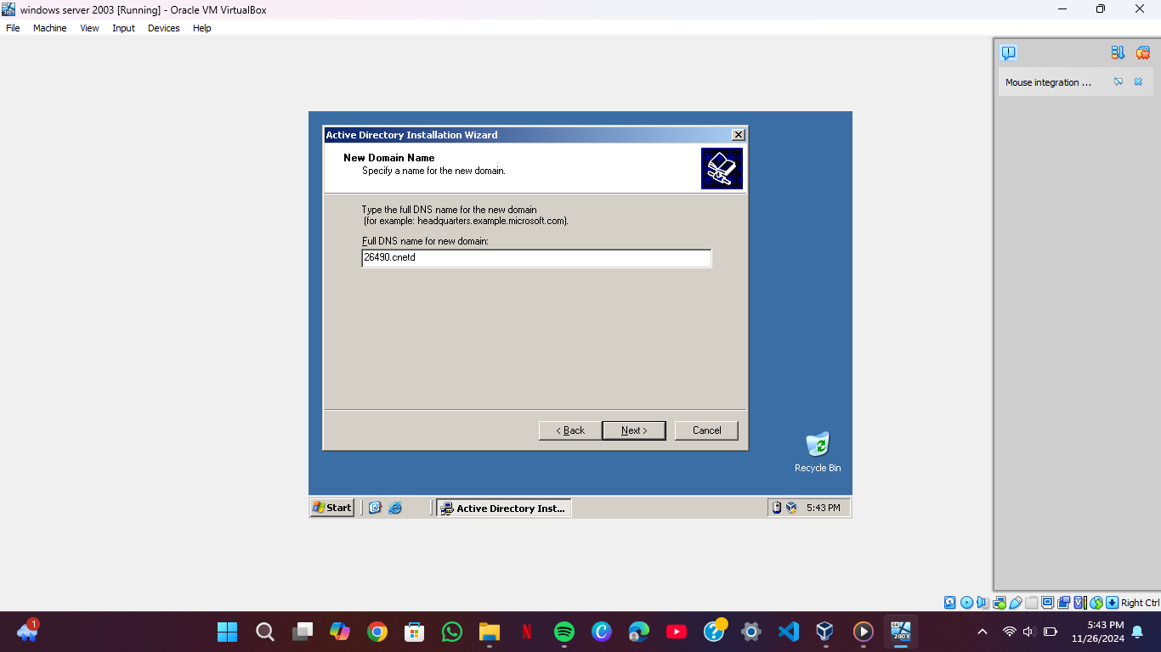
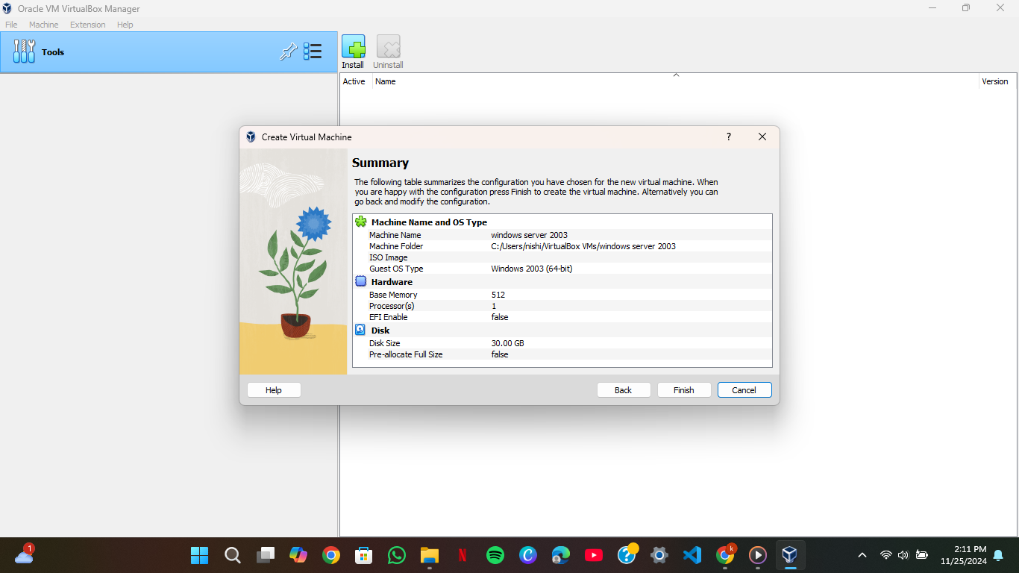
1.HARDWARE CONFIGURATION
These two sample screen shots indicates allocation of 256MB RAM for clients(XP) and 512MB RAM for servers(windows server) and also their network connection. And the domain name (screenshot3 which is named as 26490.cnetd

Slide 3
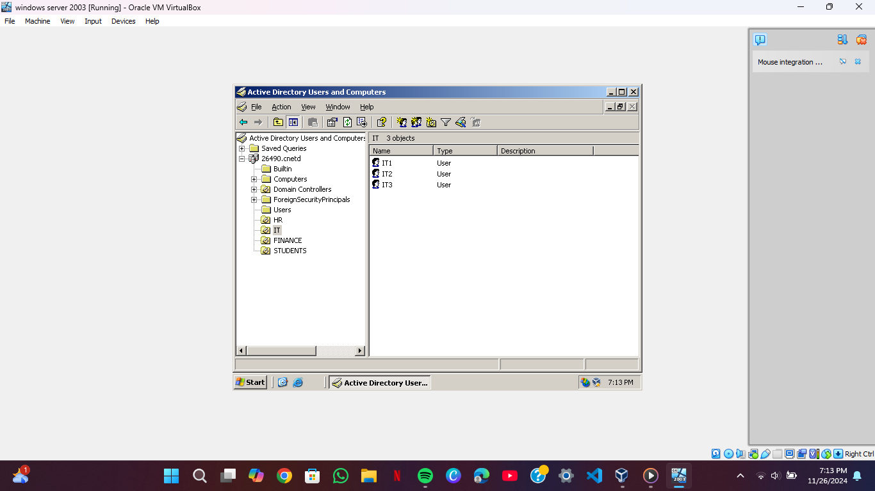
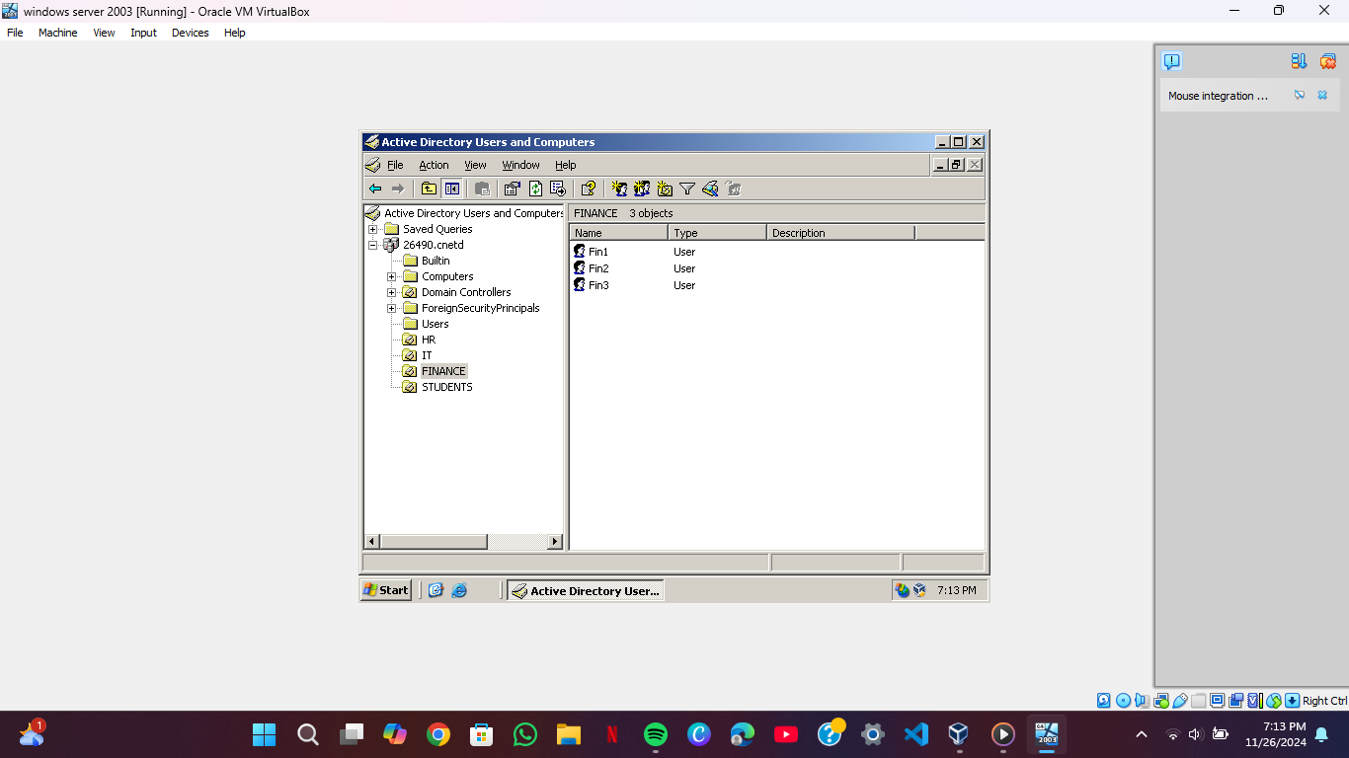
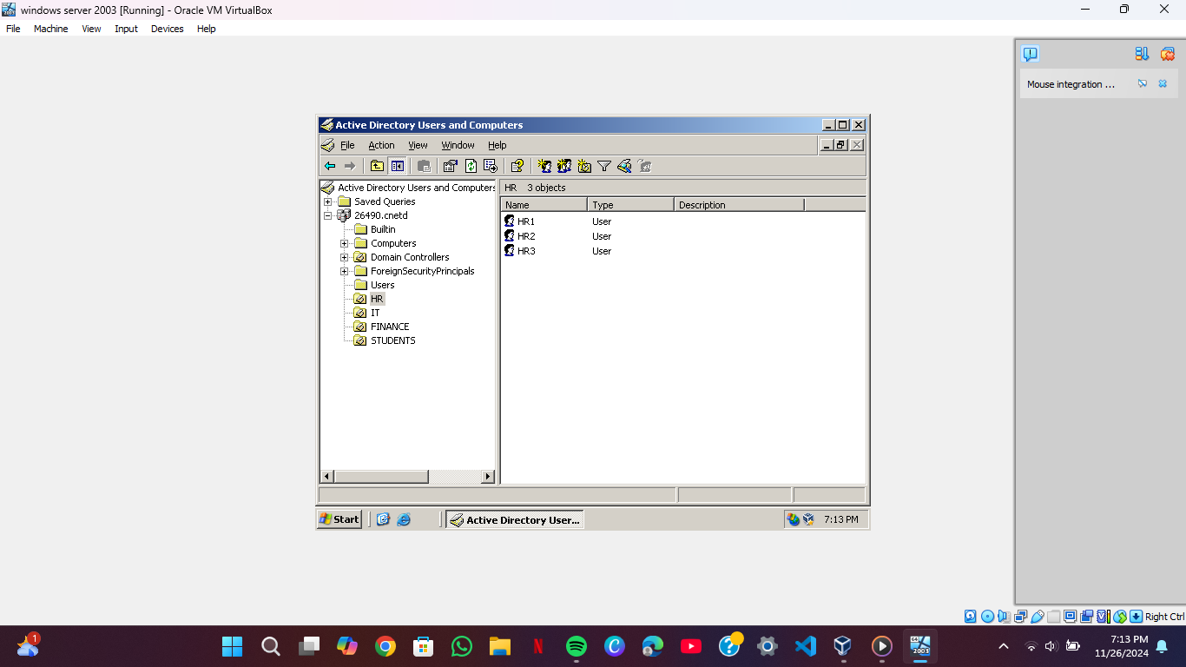
2. ACTIVE DIRECTORY SETUP
In this section I creacted users in my 26490.cnet domain and organization unities includes HR,IT,STUDENTS,FINANCE.Along with their users ex: HR1,IT2,Fin2,Student3.

Slide 4
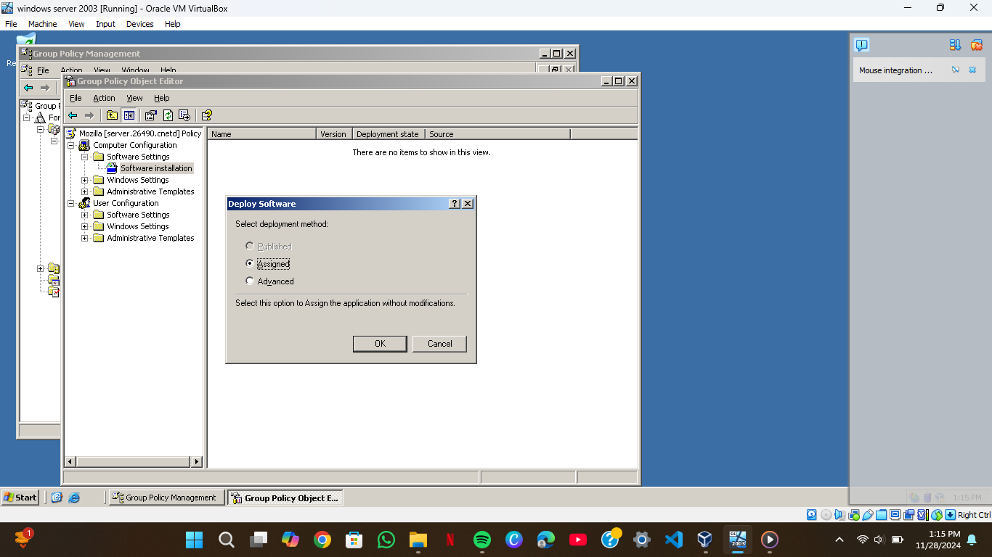
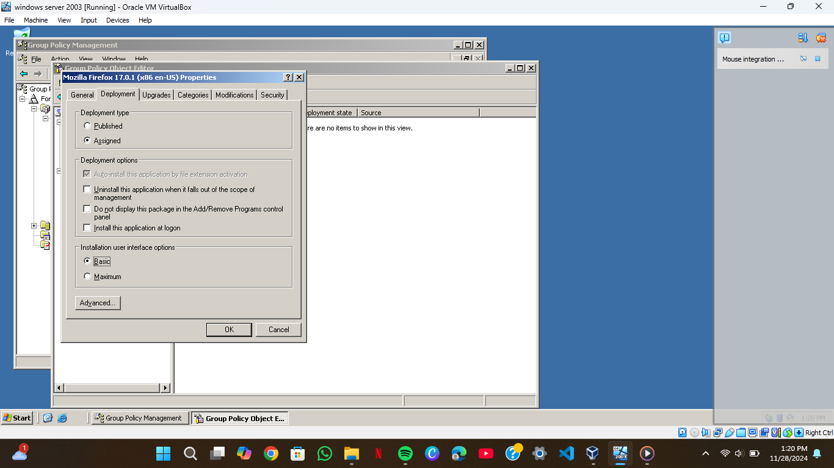
Software deployments
In software deployment I first shared my real pc with virtual machine in order to get access to the softwares I downloaded.then goes in GPO to create new gpo for my softwares that are MOZILLA and VLC to be deployed in my virtual machine

Slide 5
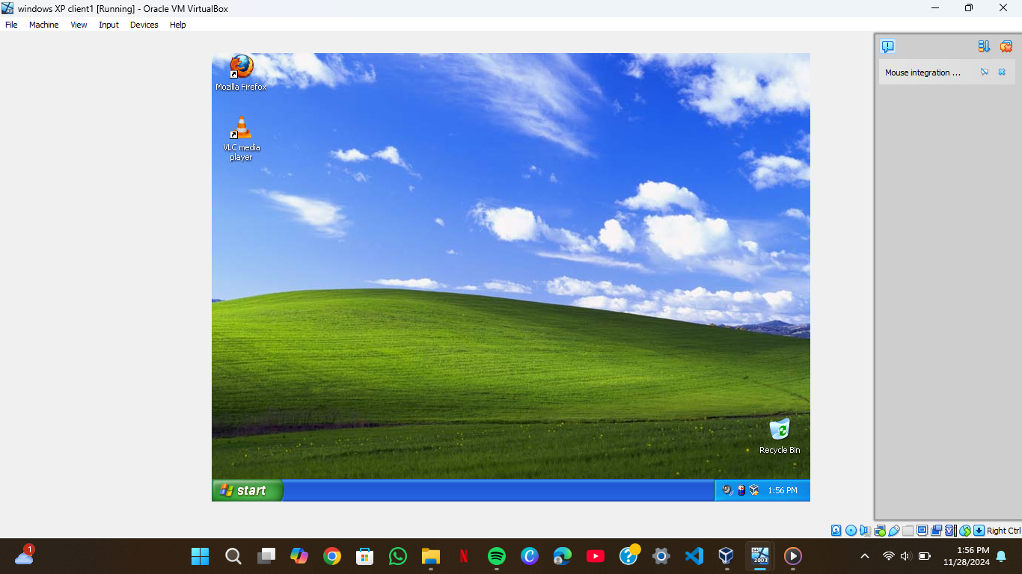
After deploying them in windows server I used gpupdate /force in server and clients to get them both in server and clients. As screenshot shows its deployment in xp.

Slide 6
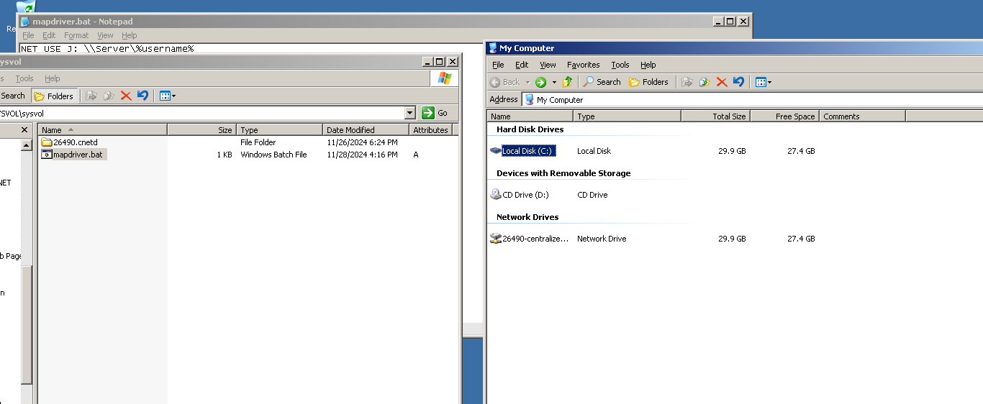




CENTRALIZED DOMAIN This screenshot shows the centralized domain and mapdriver.bat

Slide 7
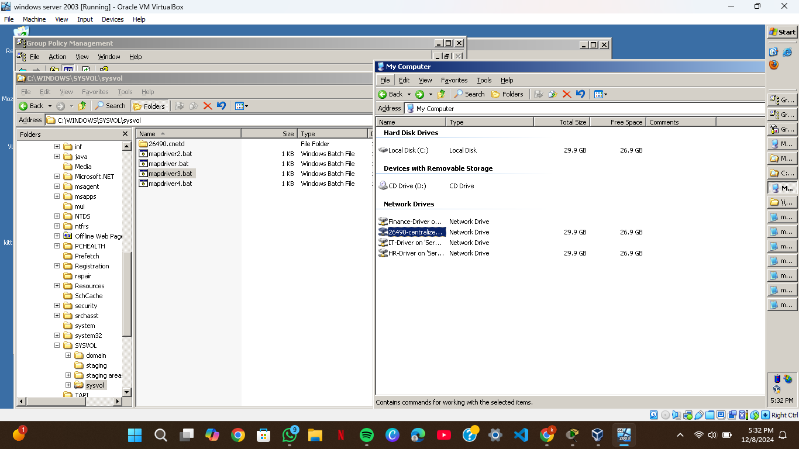
OU DRIVERS This pic shows the ou drivers and their mapdriver.bat except for students because students should have access to centrelized driver only

Slide 8
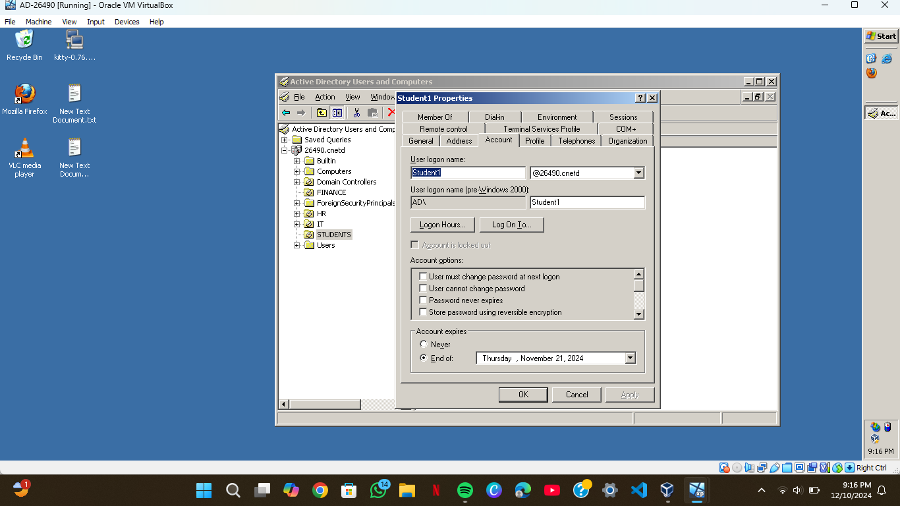
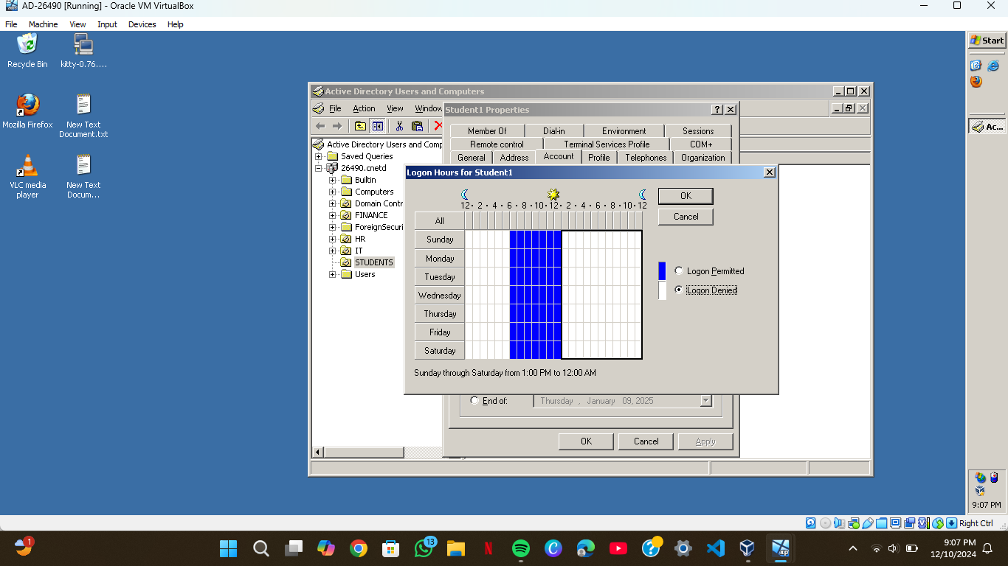
Expiration and restriction of student1 student 1expiration is on nov 21th 2024 and allowed login only from 6-12

Slide 9
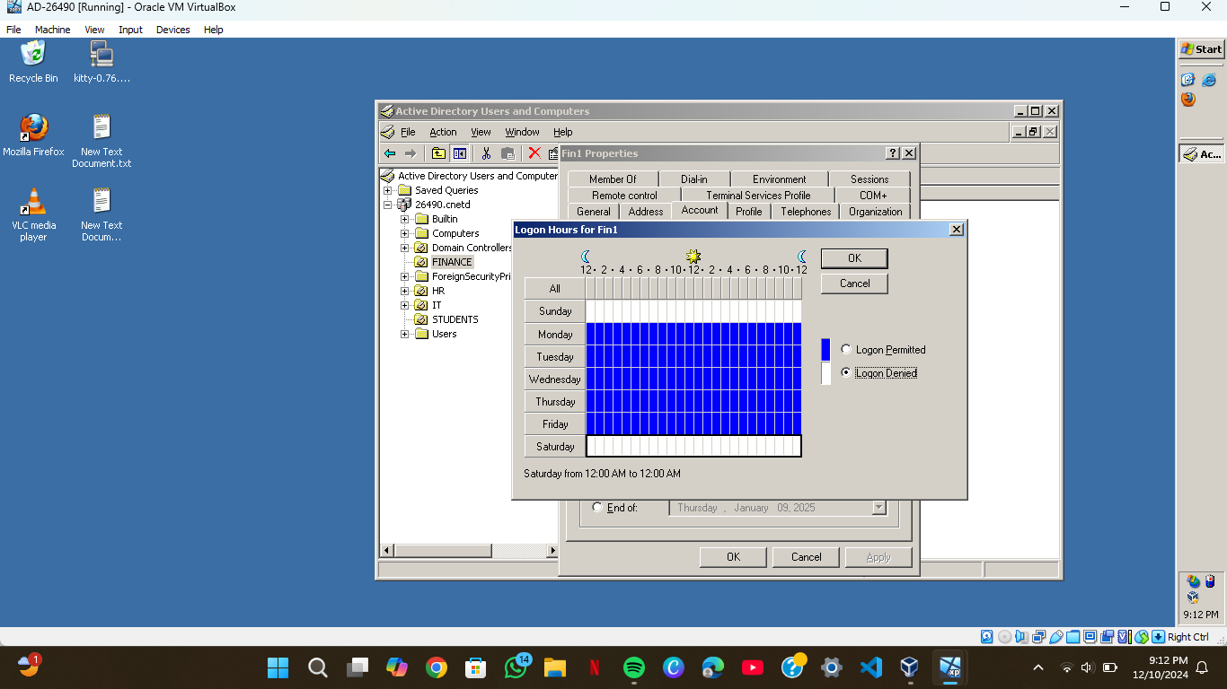
Restriction of finance night shift hrs and denied in weekends

Slide 10
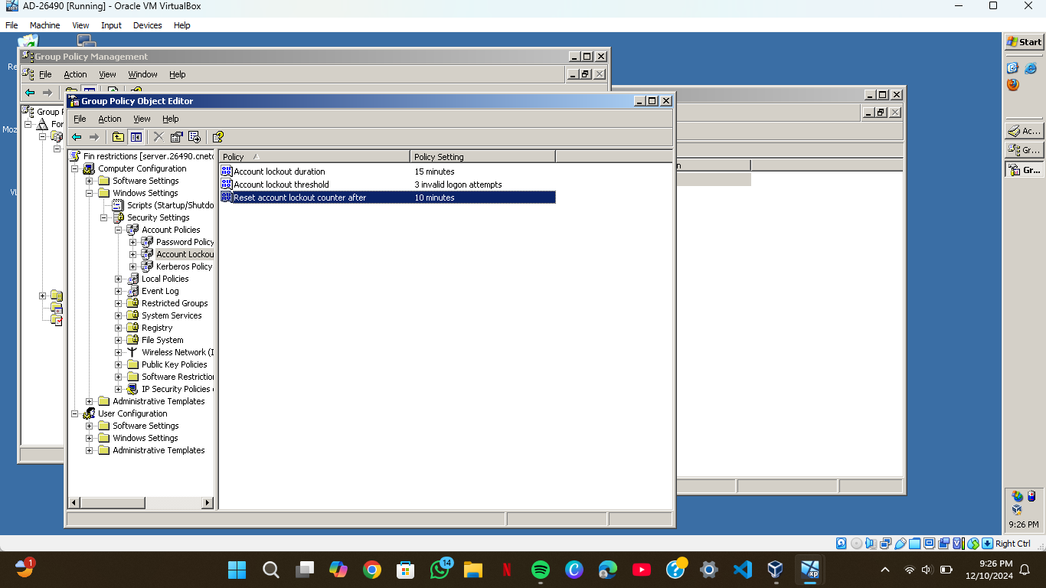
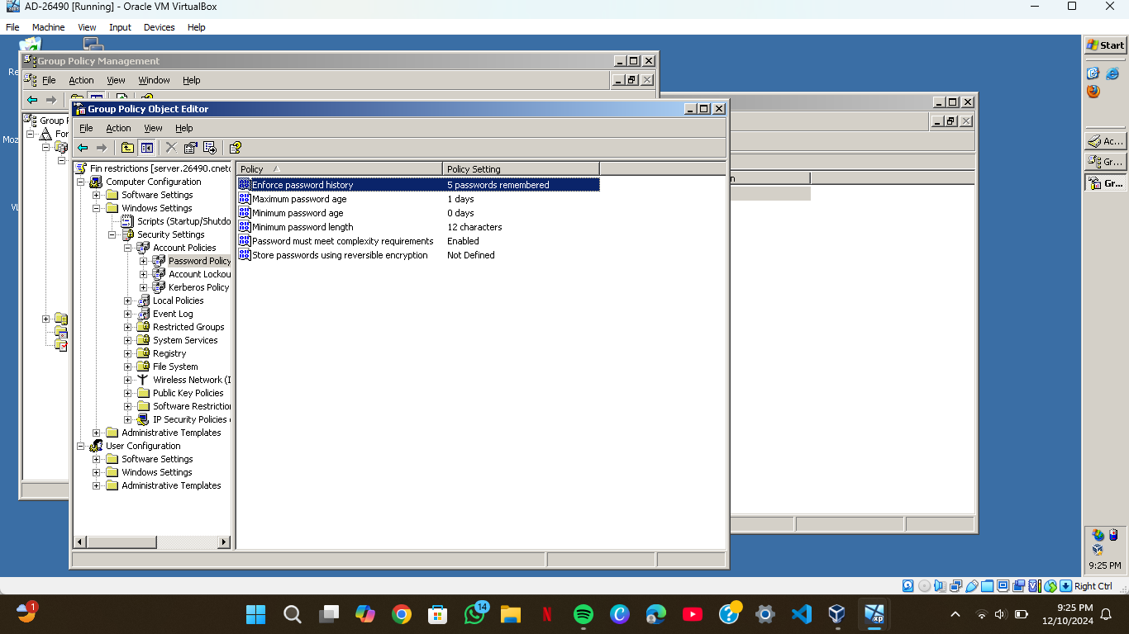
Password length,and complexity requirements,password expiration,password history and account lockout policy

Slide 11
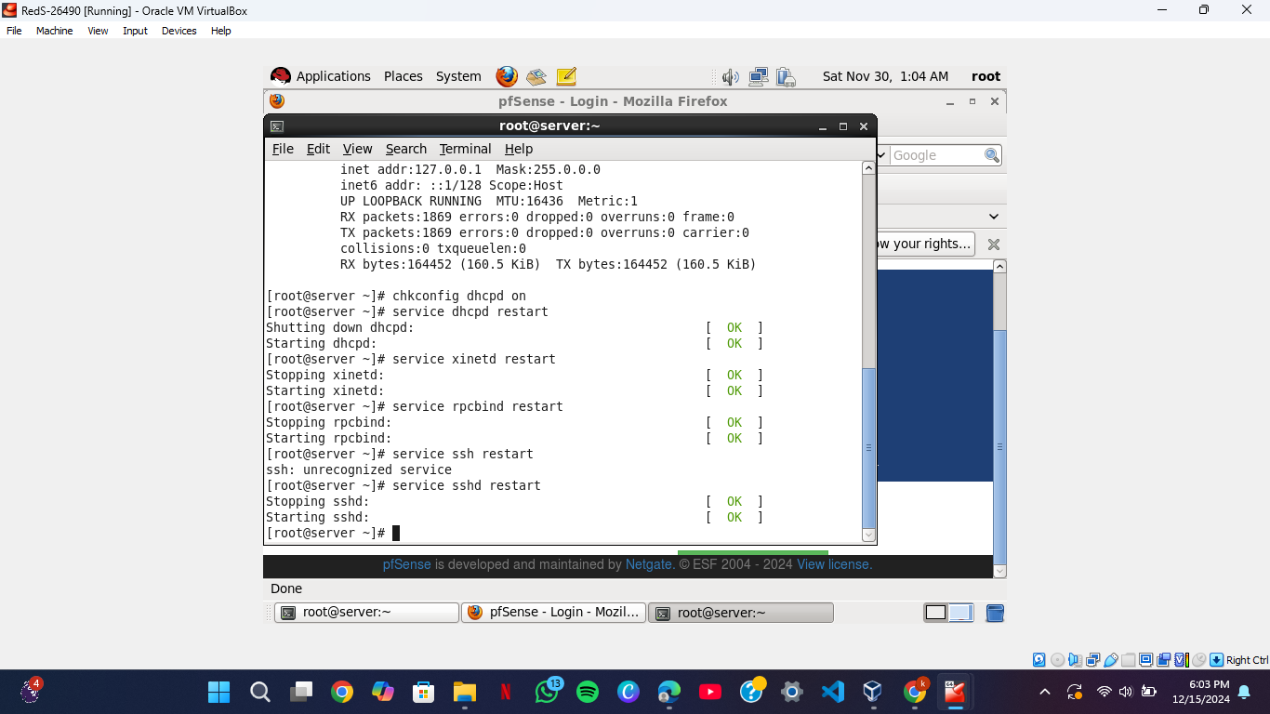
Testing ssh, dhcp in reds-26490

Slide 12
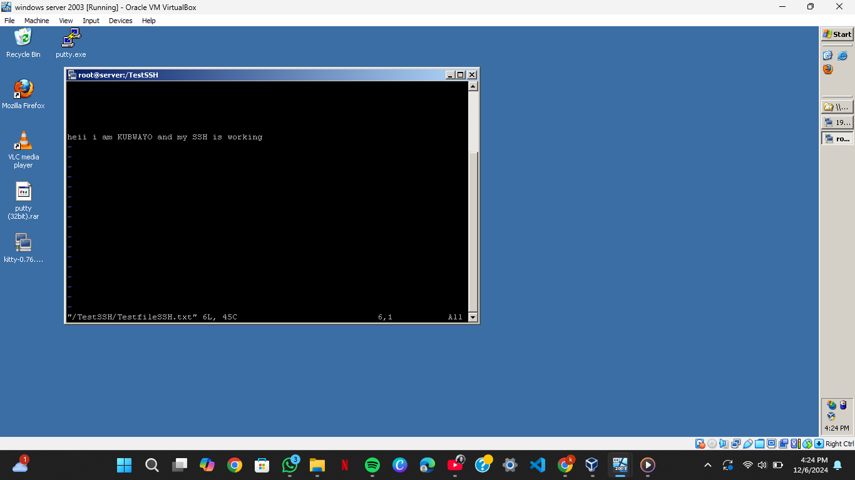
Testing ssh in server using kitty
After installing ssh in reds I opened kitty in windows server and I putted in redhat ip address which is 192.168.20.30 and then I logged in imy redhat the words in pics says “HEI MY NAME IS KUBWAYO AND MY SSH IS WORKING”.

Slide 13
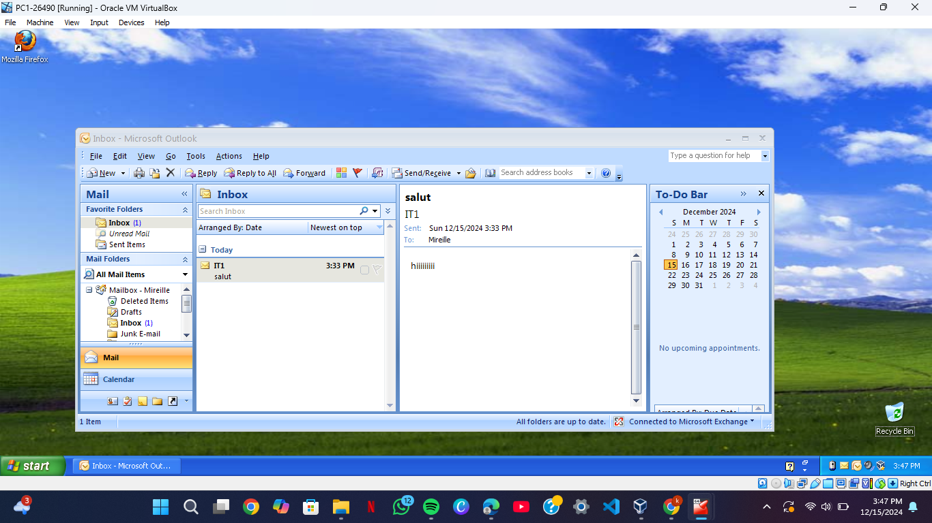
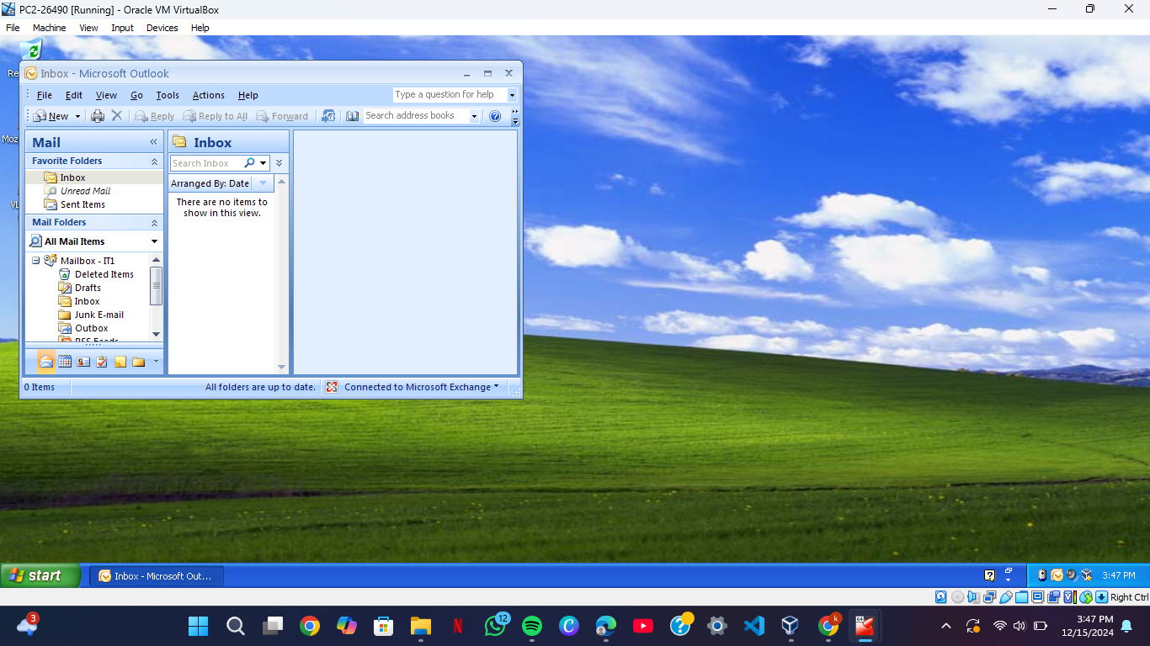
4.EXCHANGE SERVER

Slide 14
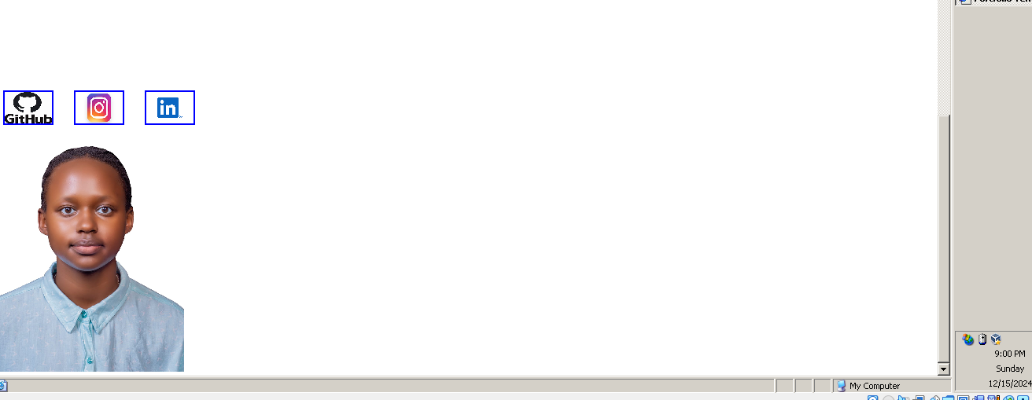
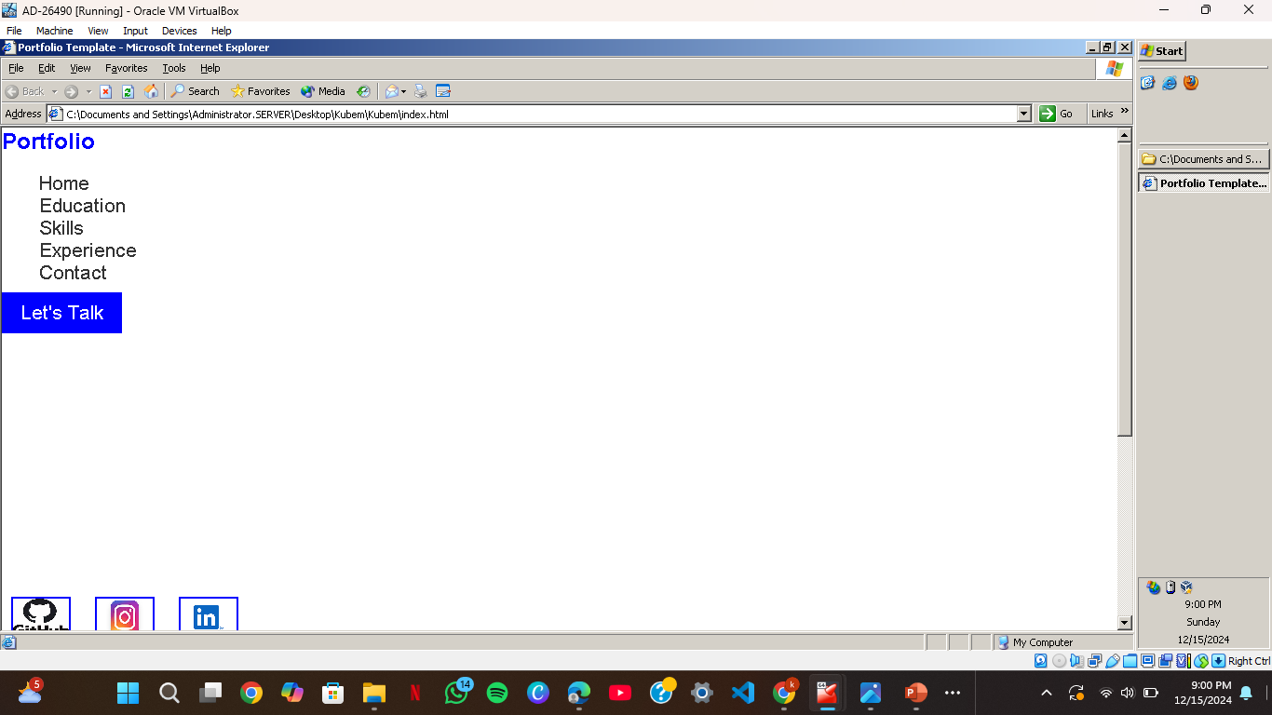
WEB SERVER IIS

Slide 15
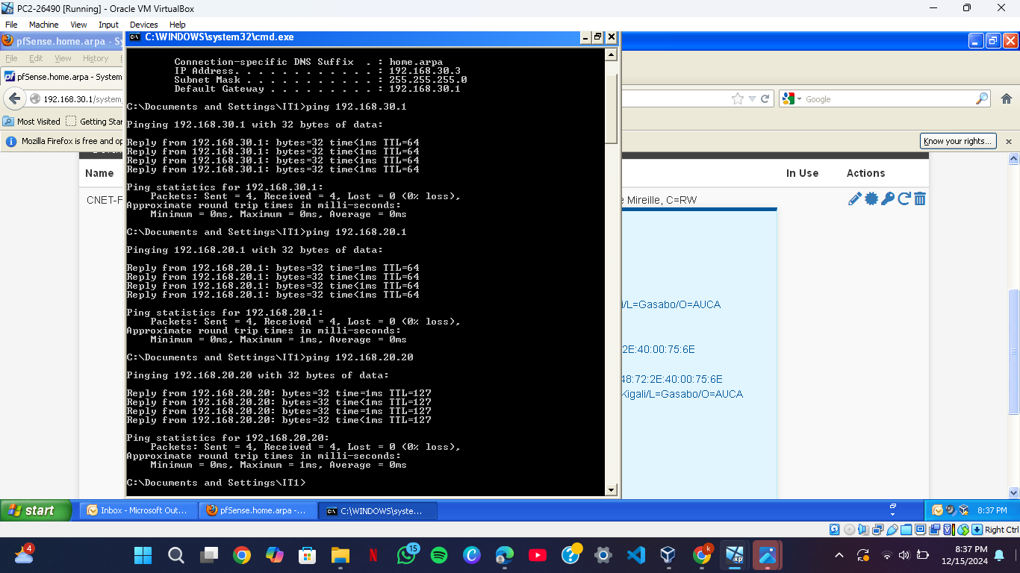
PFSENSE PC2 got an ip from home.arpa and it pings all defaults LAN1&LAN2 plus window server

Slide 16
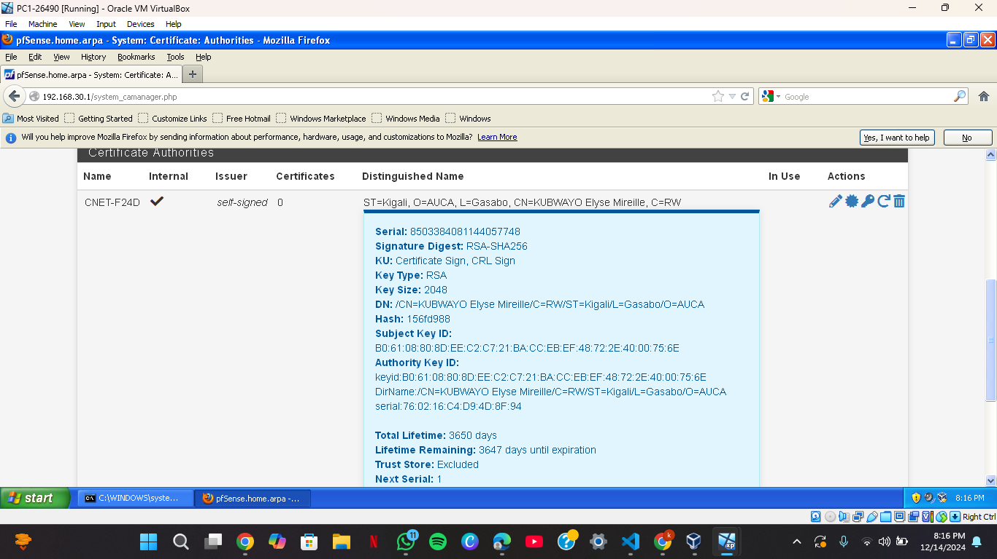
Pfsense certificate

